Slide 1
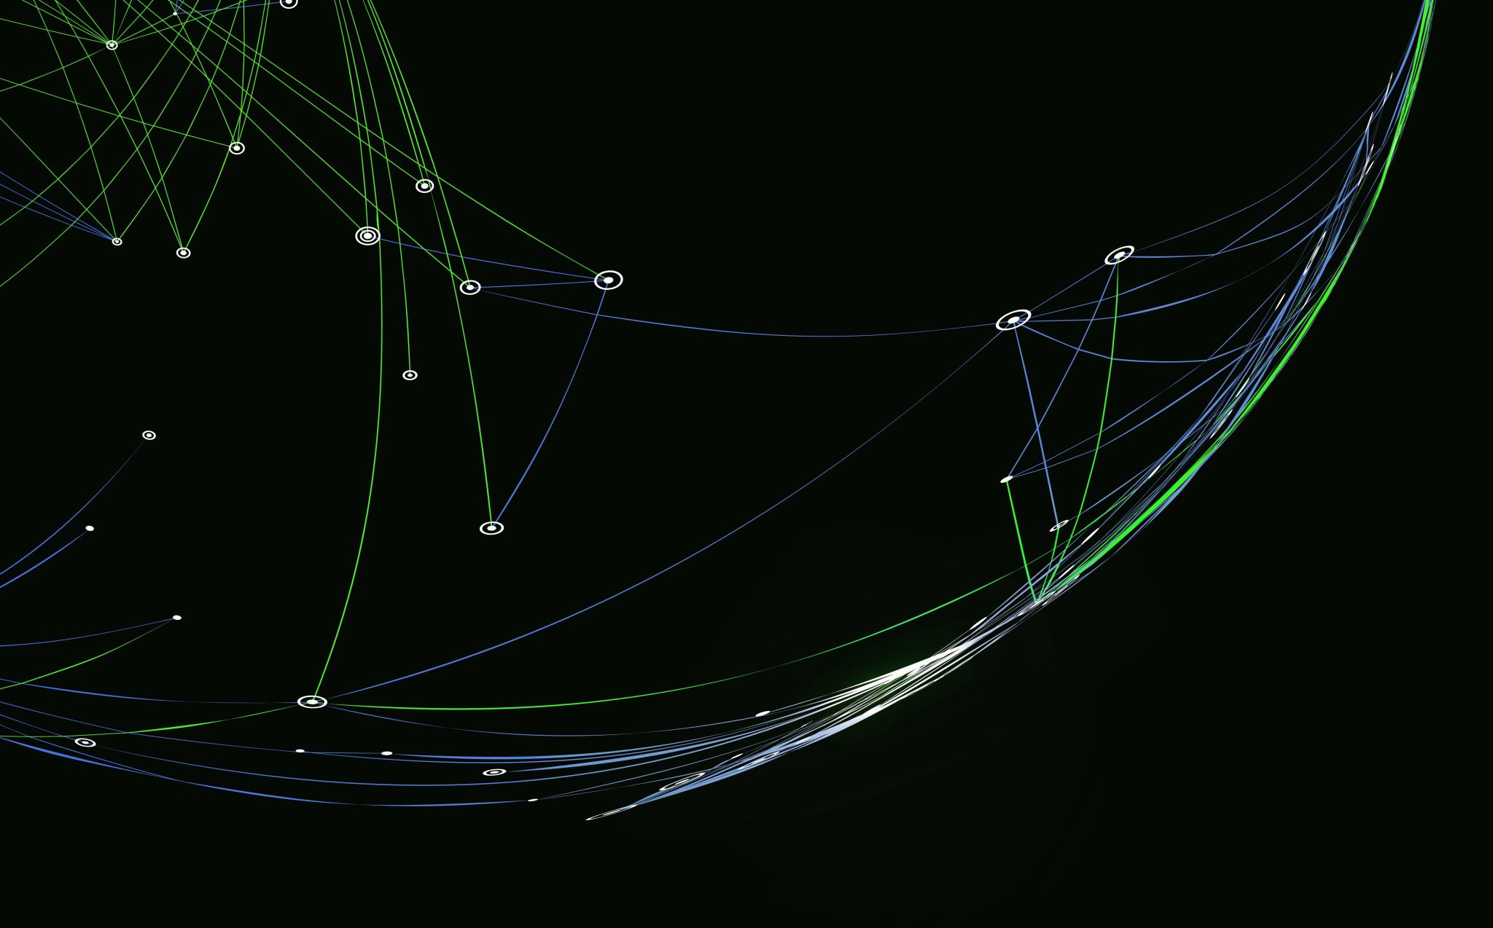
KNIME DATA APP ·
Cricket Analytics Hub
A 150-Year Data Story of Players, Dominance & Global Evolution (1876 – Present)
Name: Jilin Sebastian
Matriculation Number: 51711

Slide 2

Turning 150 Years of Cricket Data into an Interactive Story
Implementation Scope:
  Dataset Integration: Prepared and transformed multi-format historical datasets directly inside KNIME.
  3 Dashboard Views: Structured distinct interactive views containing 2–4 linked visualizations each.
  Dynamic Interactivity: Integrated widget-based filters (format selectors and country twinlists) for live exploration.
  Portability: Configured relative workflow paths for seamless deployment across environments.
The 4 Storylines Answered:
  1. All-Time Run Supremacy: Who are the historic volume giants across 150 years of international cricket?
  2. Batting Evolution: How does modern strike-rate acceleration contrast with traditional batting averages?
  3. Bowling Mastery & Standards: Which nations dominate wicket share, and how tight are global economy standards?
  4. Global Era Spikes: How did cricket transition from a 2-nation bilateral contest into an exponential global tournament phenomenon?

Slide 3
From Raw Match Logs to an Integrated Analytics Pipeline
Data Ingestion:
Batting_Records.csv — Historical innings, averages, strike rates, 100s, and 50s.
Bowling_Records.csv — Career wickets, matches, averages, and economy rates.
Series_Tournaments.csv — 2,052 match series from 1876 to the present.
Core Transformations in KNIME:
Nomenclature Standardization: Standardized legacy nation names and country codes for uniform joining.
Type Conversions & Cleaning: Converted formatted string metrics (Runs, Margin, Year) into numerical formats and handled null/missing outcomes.
Dynamic Domain Handling: Applied Domain Calculator nodes so downstream nominal widget twinlists populate dynamically without truncating historical values.

Slide 4
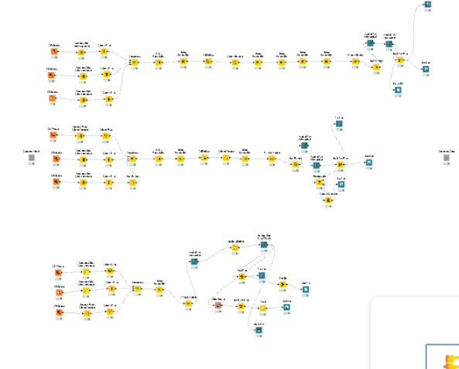

Triple-Stream Data Pipeline Architecture
End-to-End Ingestion, Processing & Component Encapsulation
Batting Stream (Top): String manipulation $→$type conversion $→$format filter widget $→$3 linked batting visualizations.
Bowling Stream (Middle): Missing value replacement $→$domain calculations $→$country selection widget $→$3 linked bowling charts.
Tournament Stream (Bottom): GroupBy aggregations $→$domain calculator $→$winner twinlist $→$3 timeline/victory charts + match log table.
Component Encapsulation: Wrapped into a single interactive layout delivering a unified dashboard view.

Slide 5
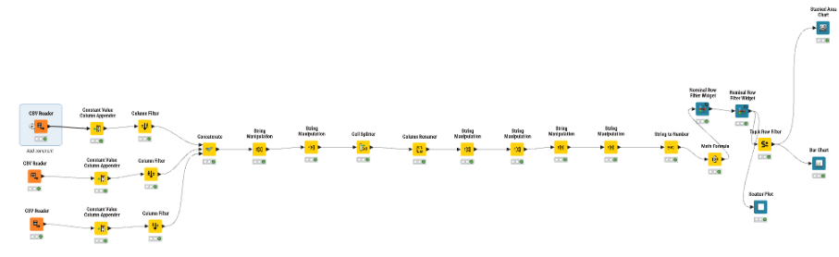

Batting Dynamics & Efficiency
Who commands run supremacy, and how do classical anchors contrast with modern aggressive hitters?
Nodes: CSV Reader $→$String Manipulation $→$String to Number $→$Math Formula $→$Nominal Row Filter Widgets.
Interactive Filters: Match Format Selector (Test, ODI, T20) and Batsman Selection.
Linked Views: 3 visualizations linked dynamically to filter selections.

Slide 6
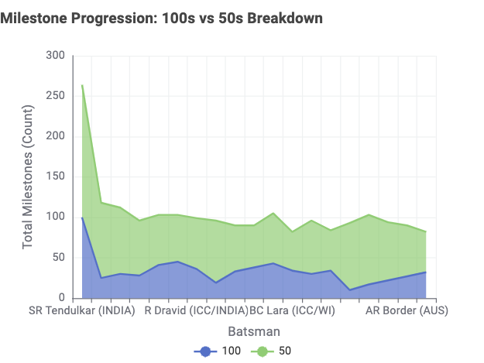
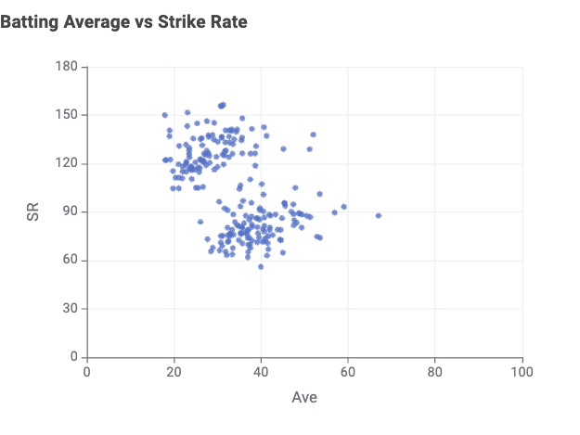
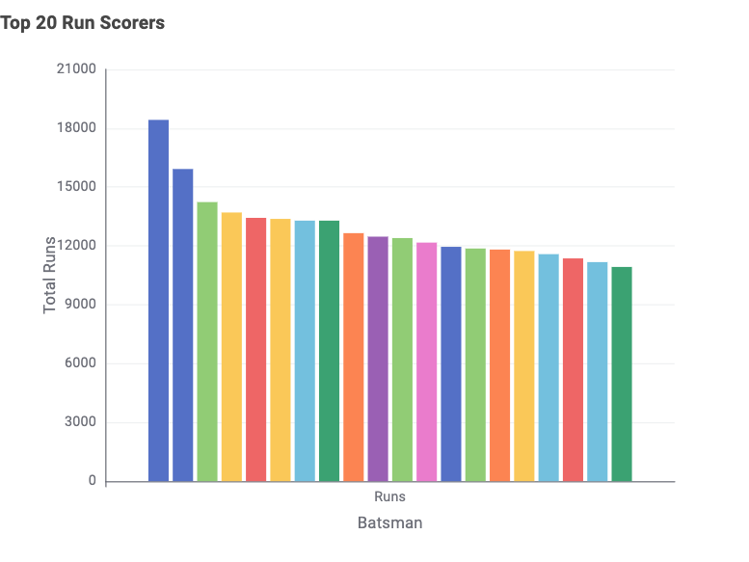
Batting Dynamics: Volume, Milestones & Speed
  Peak Run Supremacy: All-time run leader commands an 18,000+ run aggregate, with the primary elite cohort tightly grouped between 12,000 and 15,000 runs.
  Milestone Outliers: Stacked area curve reveals an extreme outlier commanding 250+ career milestones (50s & 100s combined), demonstrating generational consistency.
  Anchor vs. Striker Clustering: Scatter plot highlights distinct dual clusters—classical anchors maintaining 40+ averages at moderate strike rates (50–80) versus modern boundary-hitters accelerating to 120–150+ SR.

Slide 7
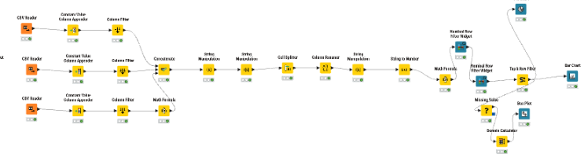

Bowling Mastery & Distribution
How is bowling dominance distributed globally, and how consistent are international efficiency standards?
Nodes: CSV Reader $→$Missing Value $→$Domain Calculator $→$Country Filter Widget $→$GroupBy Aggregators.
Interactive Filters: Country Multi-Selection Twinlist.
Linked Views: Top Wickets Bar Chart, Country Wicket Share Donut, and Economy/Average Box Plot.

Slide 8
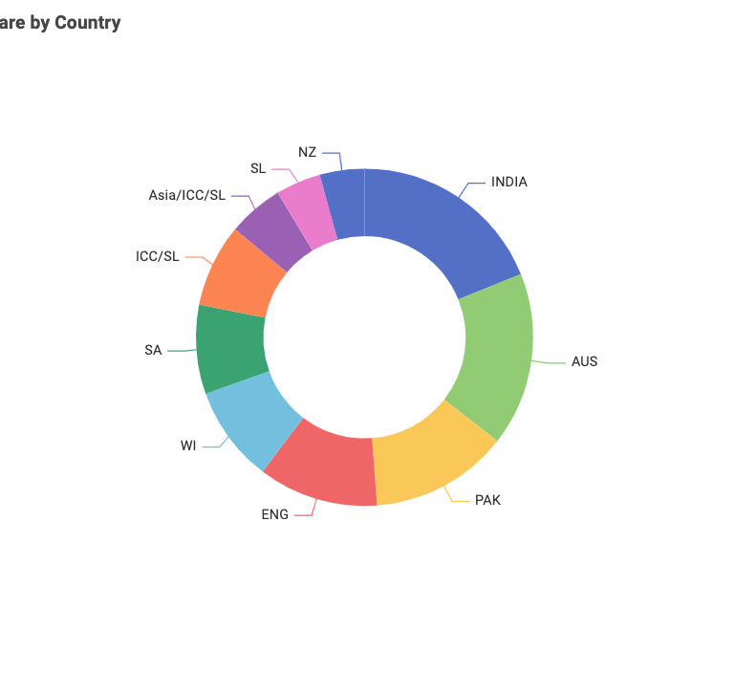
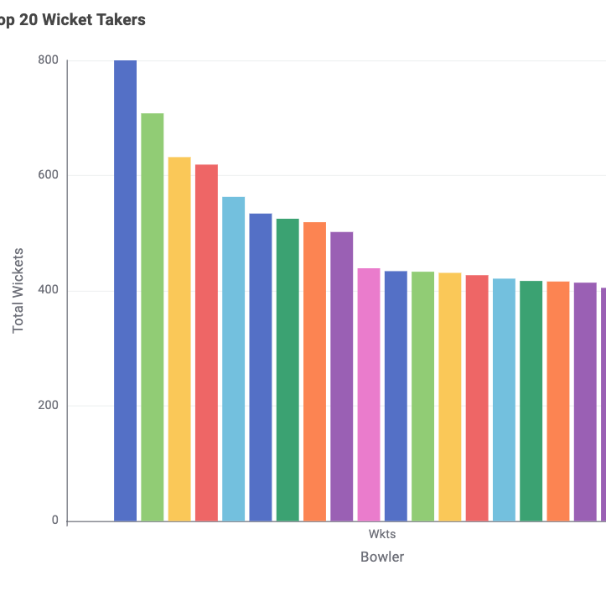
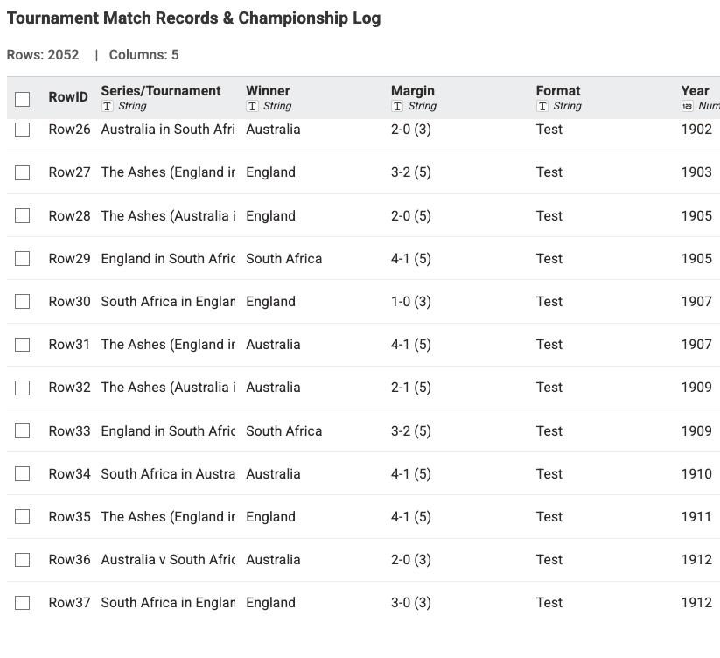
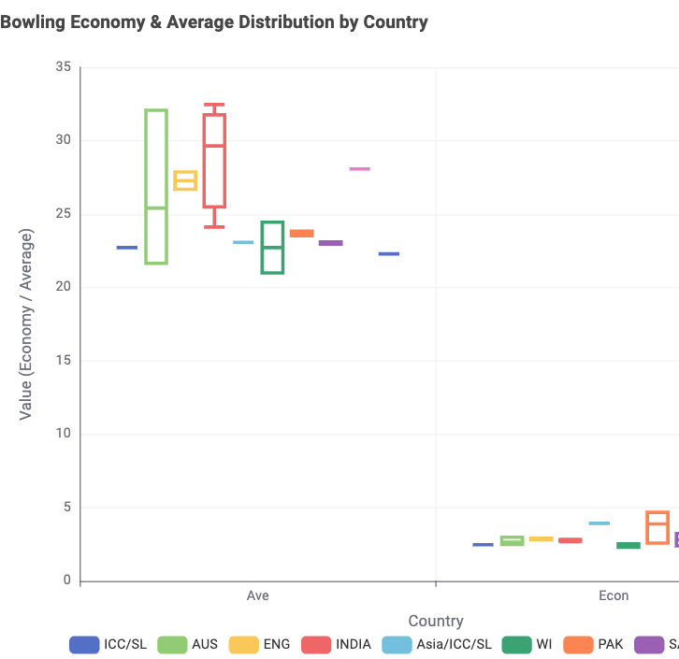
Bowling Mastery: Volume, Share & Discipline
All-Time Milestone: Peak wicket-takers surpass the historic 800-wicket benchmark, reflecting decades of sustained strike capability.
Global Wicket Distribution: Wickets are evenly distributed among traditional cricket powerhouses (India, Australia, Pakistan, England, West Indies, Sri Lanka).
Rigid Economy Corridor: While bowling averages vary significantly across conditions (20 – 32 runs/wicket), elite economy rates remain strictly confined within a tight band of 2.5 – 4.5 runs/over.

Slide 9
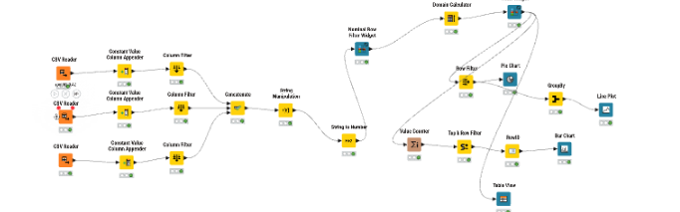

Tournament Intelligence & History
How did international cricket expand from 1876 to the present across series and championships?
Nodes: CSV Reader $→$GroupBy (Year) $→$Domain Calculator $→$Nominal Row Filter Widget (Winner Twinlist) $→$3 Charts + Table View.
Interactive Filters: Country / Winner Selection Twinlist.
Linked Views: 3 linked charts (Bar Chart, Donut Chart, Timeline Line Plot) + interactive Table View match log.

Slide 10
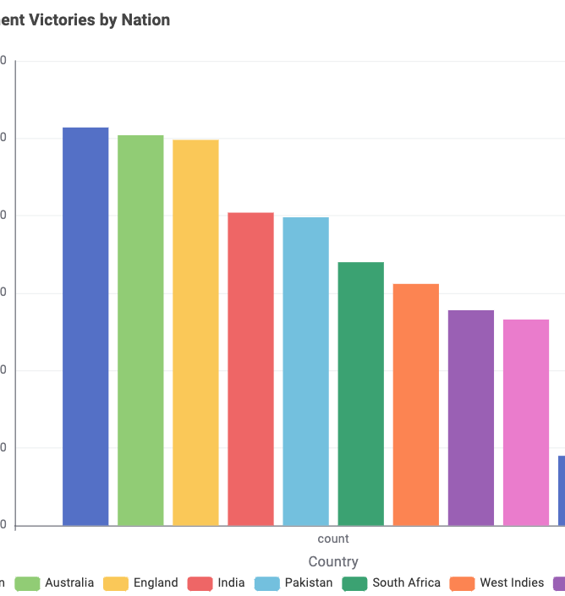
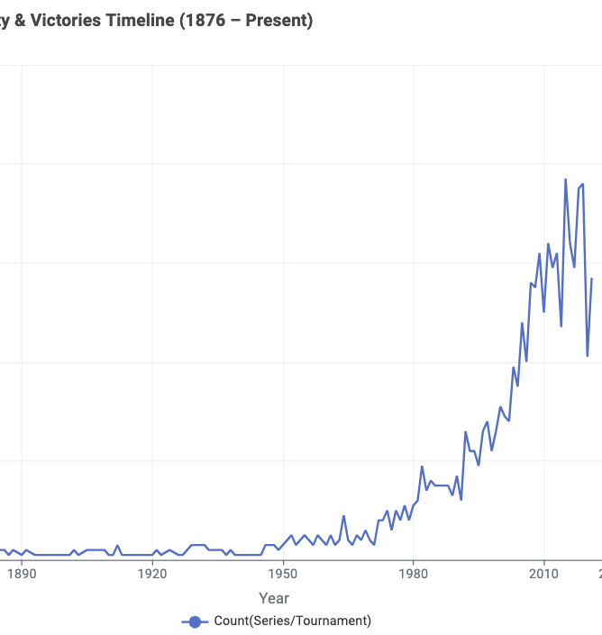
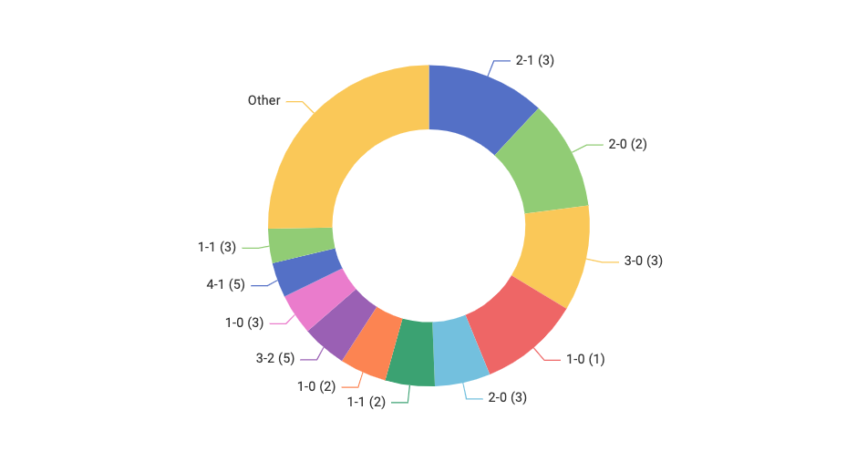
Tournament Trends: 150 Years of Global Expansion
Series Leadership: Dominated by Australia, England, and India (~200–250+ series titles each), with drawn series forming a large historical portion.
Victory Margins: Clean sweeps (2-0, 3-0) and close competitive finishes (2-1, 1-0) represent the most frequent series outcomes.
150-Year Timeline Spike: Series activity averaged under 10 per year until 1970, after which it surged exponentially to 70+ series annually driven by multi-team white-ball tournaments.

Slide 11
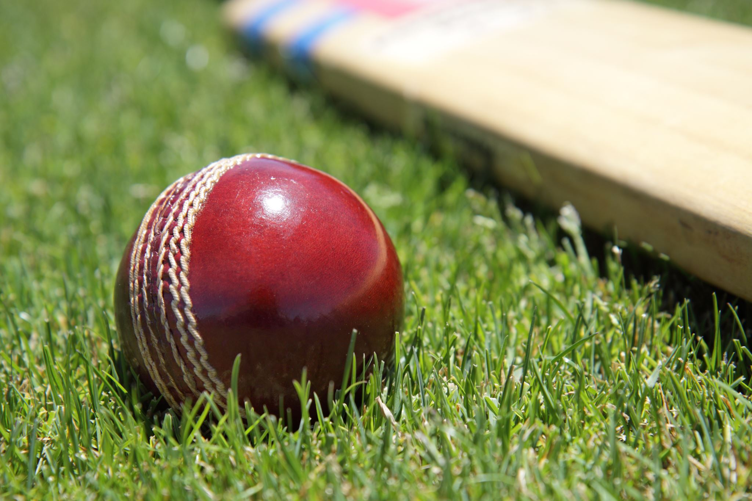

The Cricket Story, in Four Numbers
Key Statistical Benchmarks Across 150 Years of Multi-Format History
Card 1 :
  Large Number (Bold, 36–40 pt, Teal/Navy): 18,000+
  Label / Narrative: Leading Career Runs — The all-time benchmark in international cricket, defining generational batting longevity.
Card 2 :
  Large Number (Bold, 36–40 pt, Teal/Navy): 800+
  Label / Narrative: Historic Bowling Wickets — Elite career threshold achieved by all-time strike leaders across formats.
Card 3 :
  Large Number (Bold, 36–40 pt, Teal/Navy): 150 Years
  Label / Narrative: Historical Depth — Comprehensive timeline coverage analyzing 2,052 official series from 1876 to the present.
Card 4 :
  Large Number (Bold, 36–40 pt, Teal/Navy): 70+ / Year
  Label / Narrative: Modern Era Series Peak — Exponential annual tournament growth post-1970 compared to $<10$series per year pre-1970.

Slide 12
What This KNIME Data App Delivers
Dashboard & Visualization Scope
  3 Dedicated Interactive Views: Batting Dynamics, Bowling Mastery, and Tournament Intelligence.
  9 Visualizations Total: Bar charts, scatter plots, stacked area graphs, donut charts, box plots, line timeline, and an interactive match table.
  • Dynamic Filter Controls: Match format toggles and country selection twinlists driven by automated domain calculations.
Architecture & Submission Artifacts
  End-to-End Pipeline: Clean data lineage from 3 raw CSV streams to clean, deduplicated, and aggregated analytical components.
  Portable Deployment: All file readers configured with workflow-relative paths for seamless execution across machines.
  Complete Submission Package: Exported .knar workflow bundle with embedded data alongside this documentation deck.

